Slide 1
From Dense Predictions to Sparse Realities: Decoding the Future of Object Detection
Dragan Alexandru-Samuel

Slide 2
Contents
What is Object Detection?
How did we do it before end-to-end?
Why we want it end-to-end?
How do we make it end-to-end?
End-to-end architectures

Slide 3
Object Detection
A method to determine the position and class of objects in an image
Real-world => Multiple objects, multiple classes
Multiple types of doing it
Bounding box
Mask

Slide 4
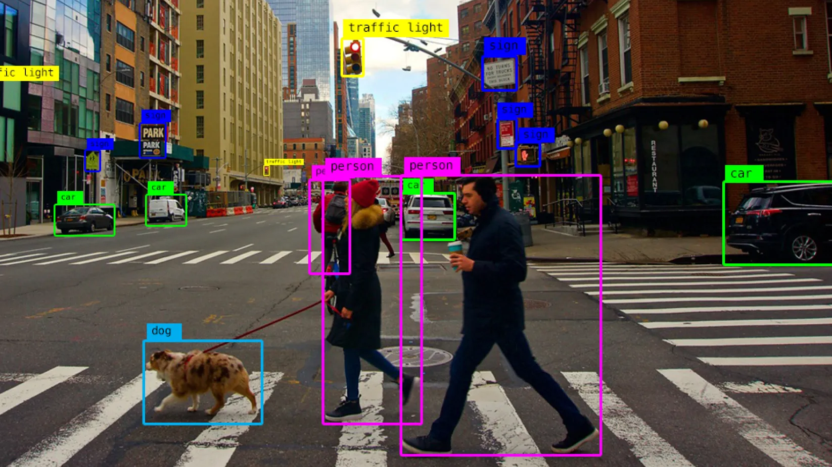

Slide 5
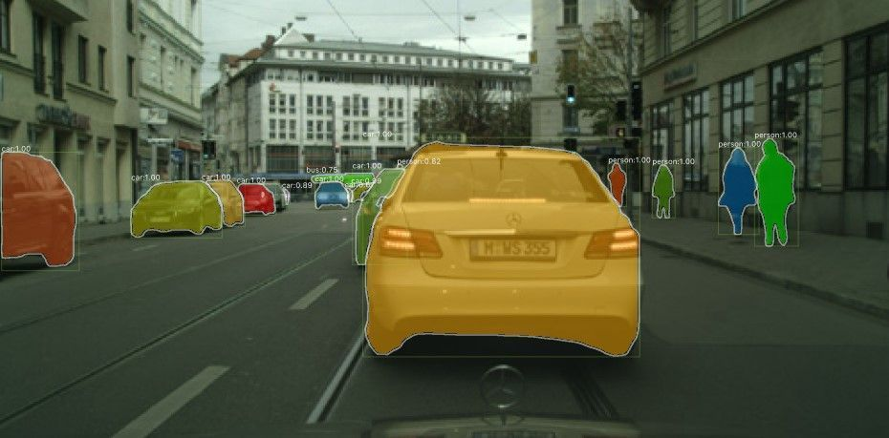

Slide 6
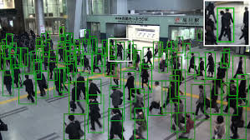
What’s so hard about it?
Objects can be (partially) occluded
Image may contain a large number of them

Slide 7
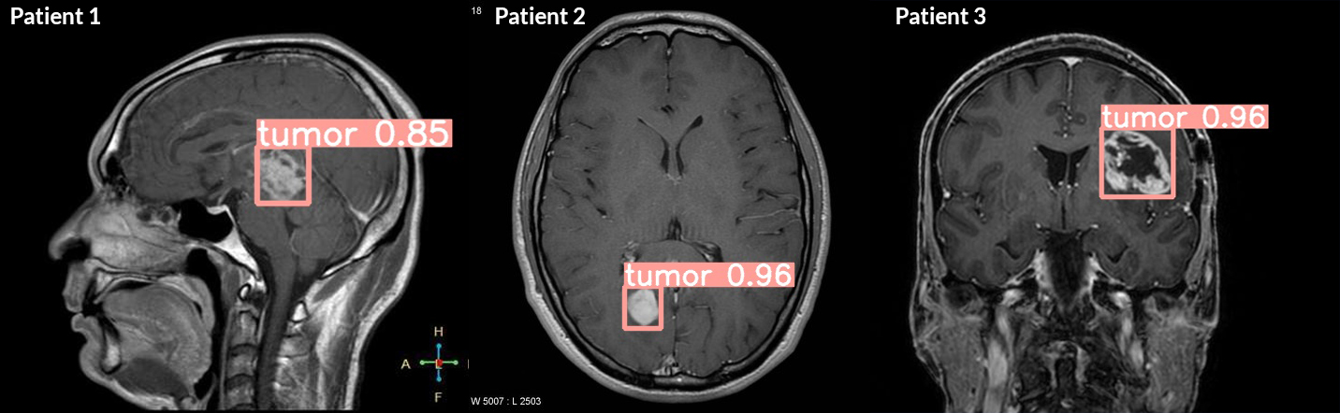
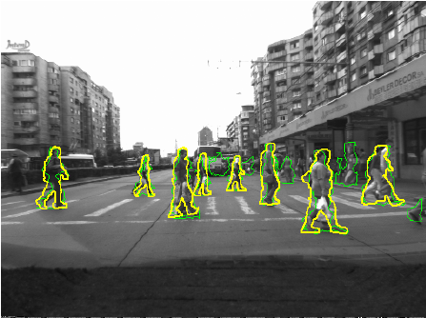
Why do we care about it?
Tumor detection
Fall detection in elderly people
Obstacle & pedestrian detection in autonomous driving
and we’re only getting started…

Slide 8
How did we do object detection?
Two types of algorithms
Two stage object detectors
First model => extracts regions of interest
Second model => refines and classifies those regions into objects
One stage object detectors
One model to do it all

Slide 9
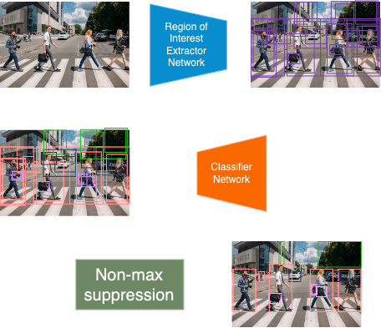
Two-stage Detector

Slide 10
Some Two-Stage Detector Algorithms
R-CNN (2013, Ross Girshick et al.)
Fast R-CNN (2015, Ross Girshick)
Faster R-CNN (2015, Ren et al.)
Mask R-CNN (based on Faster R-CNN, 2017, He et al.)

Slide 11
Two-Stage Object Detector
More accurate
Better at localization
More complex models
Bigger models

Slide 12
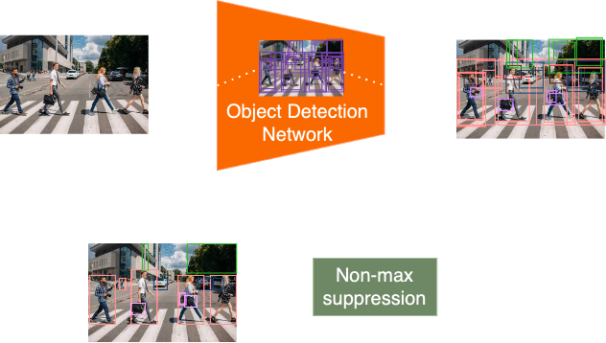
One Stage Detector

Slide 13
Some One-Stage Detector Algorithms
SSD (2015, Liu et al.)
YOLO Family
YOLO (2015, Redmon et al.)
YOLO 9000 (2016, Redmon et al.)
YOLO V3 (2018, Redmon et al.)
FCOS (2019, Tian et al.)

Slide 14
One-Stage Object Detector
Simpler models
Suitable for real-time detection
Less accurate (esp. for smaller objects)
Worse at localization

Slide 15
The problem with current models
Create lots of object candidates
Additional algorithms are needed for image pre/post-processing
E.g.
YOLO uses K-Means to find optimal bounding box sizes
Most algorithms require NMS as a post-processing step

Slide 16
The Solution? Go End-To-End..

Slide 17
Why end-to-end?
Model is simpler
The model learns better ways to solve a task
E.g: in NLP it achieved state-of the art performance
Neural Machine Translation
Text to Speech

Slide 18
How do we go end-to-end?
Flow in the “Classic” way - during training
1. Pass image through model
2. Create lots of RoIs
3. Reduce (classify them)
4. Reduce (NMS)
5. final bounding boxes
6. Compute localization (bbox) and classification error
7. Backprop

Slide 19
How do we go end-to-end?
The “New” way - during training
1. Pass image through model
2. Extract a fixed set of bbox candidates (e.g 100) and classify them
3. Final set of predictions
4. !!! Compute loss between set of predictions and set of ground truths
5. Backprop

Slide 20
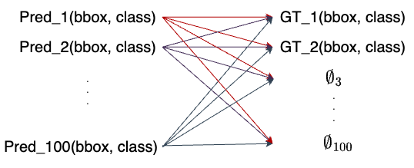
Enter bipartite matching loss
What it does?
1. Take set of predictions
2. Take set of ground truths
3. Computes “distance” between each (pred., truth) pair
=> Optimally assign a Prediction to a Ground Truth (Hungarian algorithm)

Slide 21
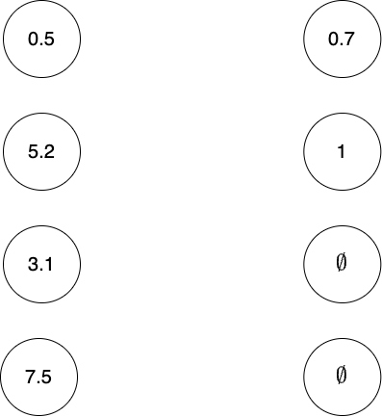
Bipartite matching loss - An example

Slide 22
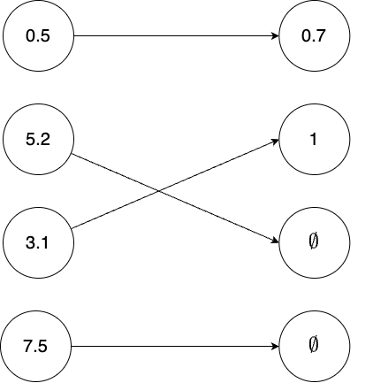
Bipartite matching loss - An example

Slide 23
Enter bipartite matching loss
How do we compute the “distance”?
Distance between the BBoxes (IoU & L1 distance)
Distance between the classes (cross-entropy)
Combine them linearly (e.g: ɑ * L_class(pred_c, gt_c) + ꞵ * L_bbox(pred_bbox, gt_bbox)

Slide 24
End to end architectures
DETR (DEtection TRansformer) (2020, Carion et al.)
Sparse-RCNN (2021, Sun et al.)
DeFCN (2020, Wang et al.)

Slide 25
DEtection TRansformer (DETR)
Transformer based encoder-decoder network
Loss = Hungarian loss
Fixed number of Object queries - guide candidate creation

Slide 26
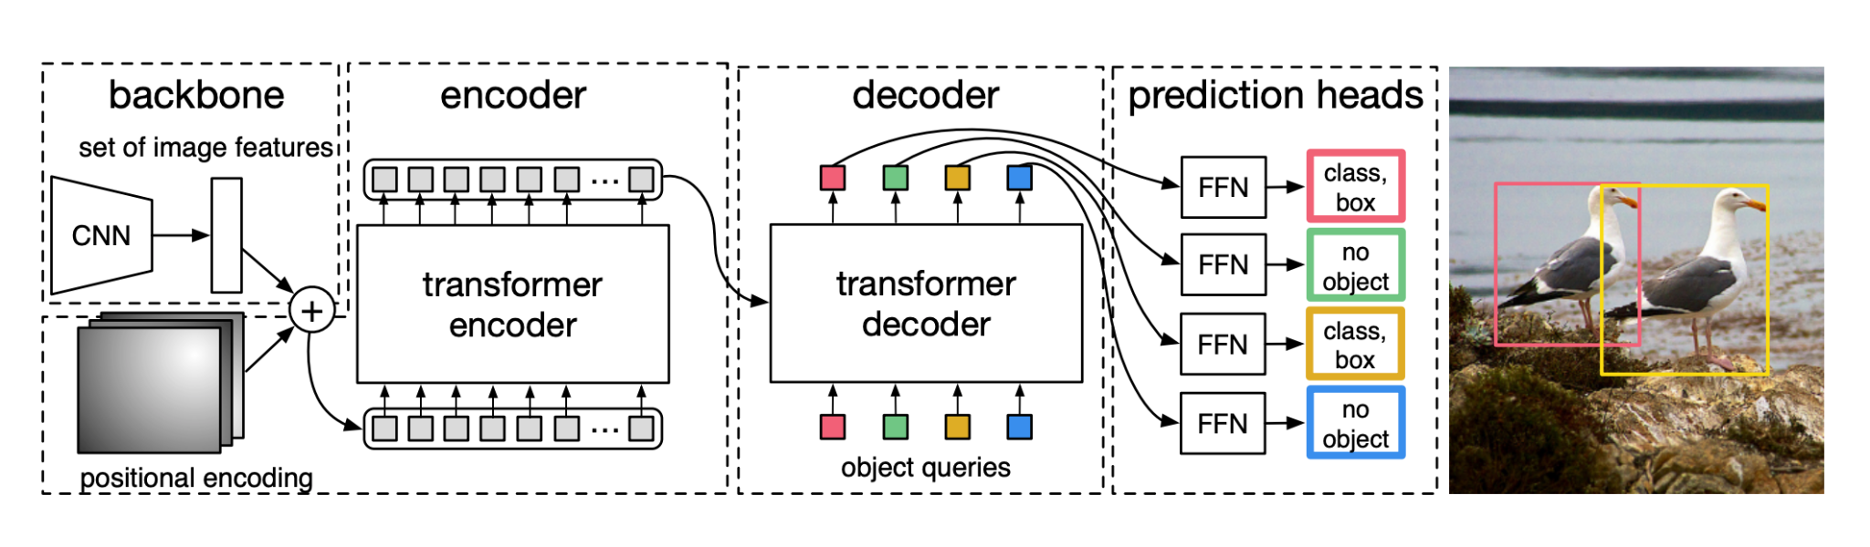
DEtection TRansformer (DETR)
Image by authors

Slide 27
Sparse R-CNN
Based on Faster R-CNN
Uses a fixed number of objects
Sparse boxes
Sparse candidates
Dynamic Instance Interactive Head
Iterative design
Combines (box, candidate) pair to extract prediction

Slide 28
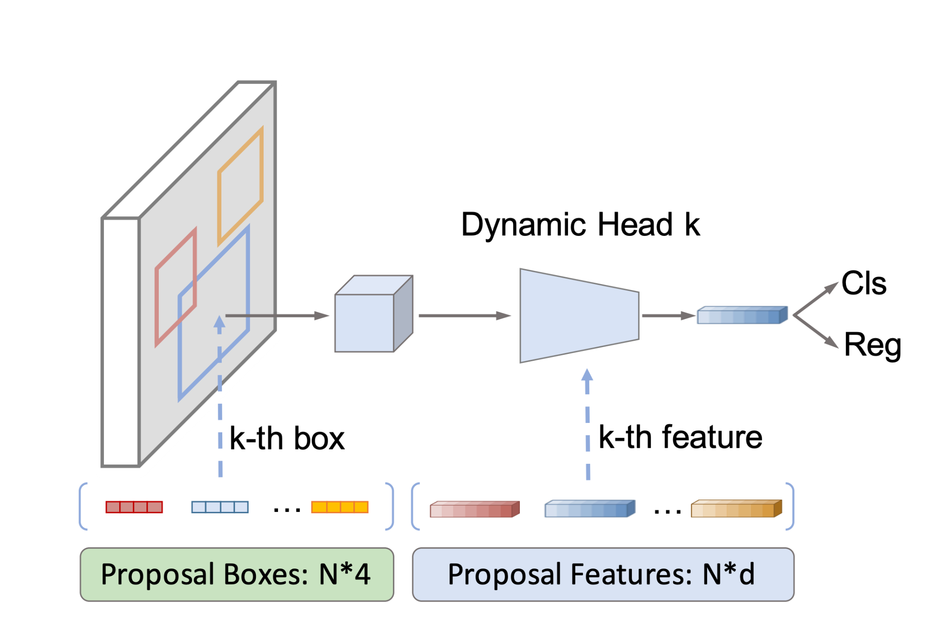
Sparse R-CNN
Image by authors

Slide 29
DeFCN (Detection Fully Convolutional Network)
Based on FCOS
Improved Loss - Prediction aware one-to-one assignment (POTO)
Geometric mean to build the loss
3D Max Filter (3DMF) to act as NMS

Slide 30
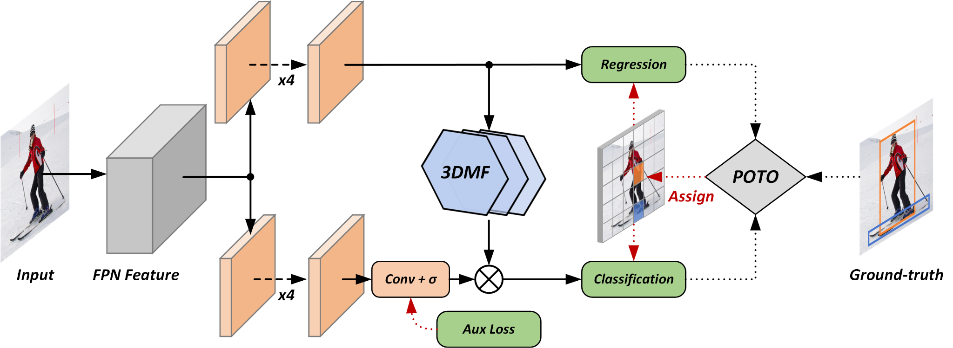
DeFCN (Detection Fully Convolutional Network)
Image by authors

Slide 31
Thank you!

